Slide 1
Expedited Learning with Interactive Demonstrations
Brandon Rozek
Advisor: Dr. Ron Zacharski

Slide 2
Outline
Defining Reinforcement Learning
Breakthroughs and Issues
Interactive Demonstrations
Outline 3 Stages
How does an agent know what to do?
Results

Slide 3
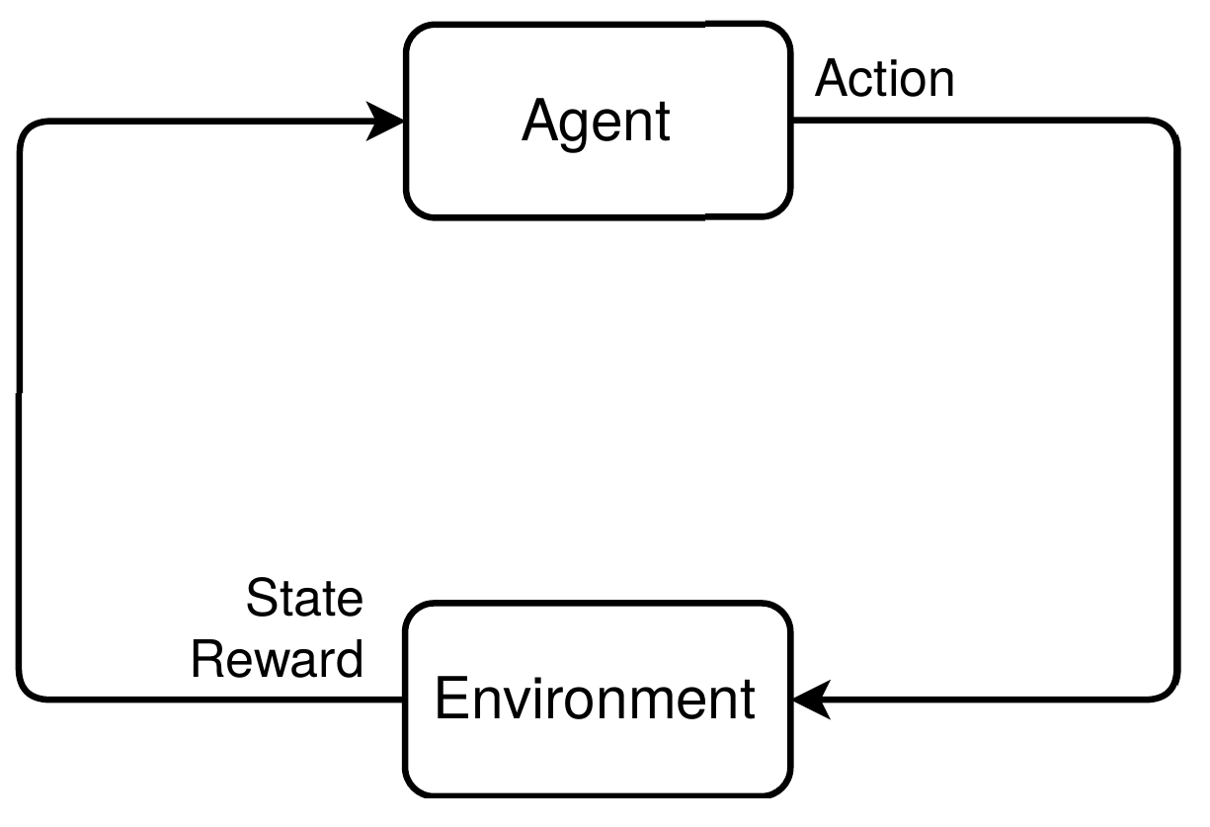
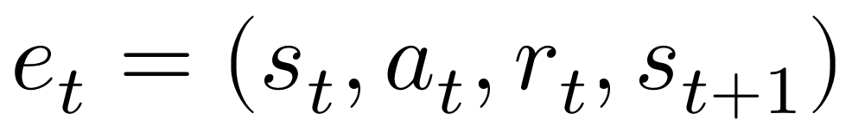
Reinforcement Learning Problem
What sequential decisions should be made to maximize a reward?
Agent performs an action
Environment rewards the action and provides a new scenario

Slide 4
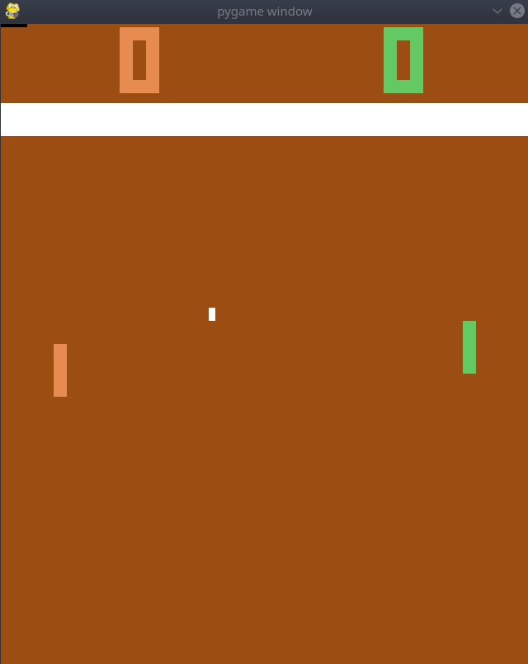
Example: Pong
State is the current image on the screen
Possible Actions: Move green paddle up or down
Reward:
  +1 If green scored against orange
  -1 If orange scored against green
  0 Otherwise

Slide 5
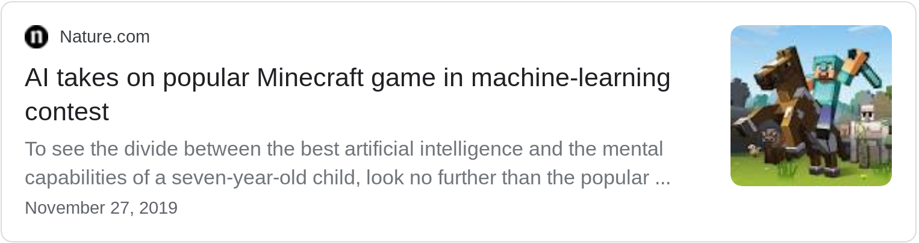
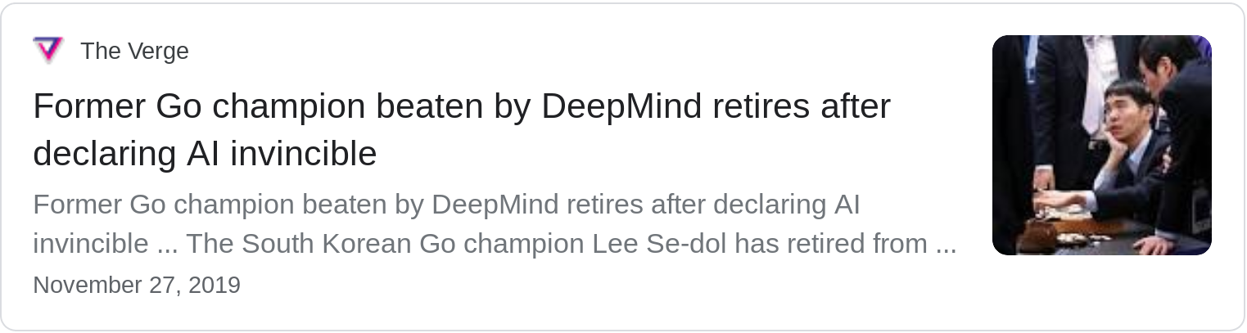

Slide 6
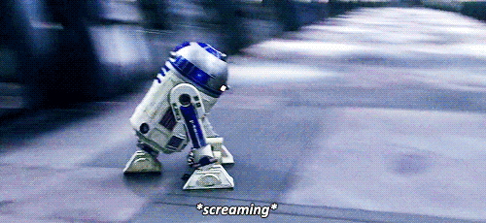
Current Issues
Tons of environment interaction needed!
Decent performance reached after thousands of game play sessions
An agent may face actual consequences while learning
Physical damage to robotic agent or objects in the environment
Sometimes both

Slide 7
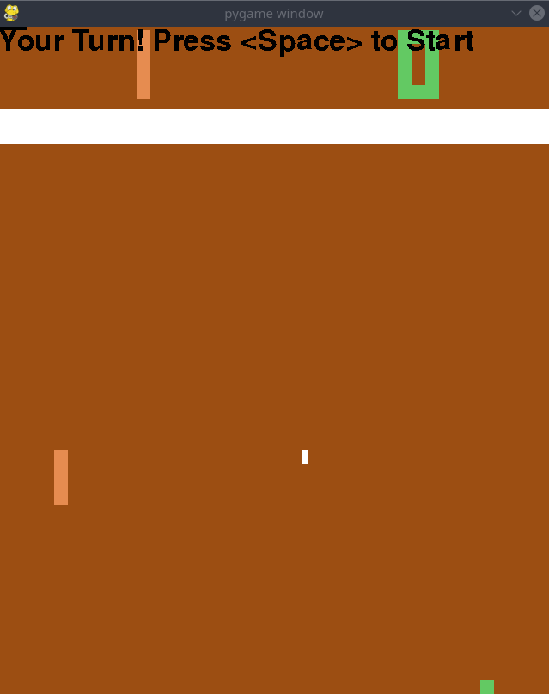
Adding Demonstrations
Demonstration data can be used to help expedite the learning process
This provides the agent with an example of how to interact with the environment

Slide 8
One Approach: Imitation Learning
Looking at many examples of demonstration data, can we predict what action a demonstrator will take?
Limitation
Agent can not become better than the demonstrator.

Slide 9
Interactive Demonstrations

Slide 10
3 Stages of Interactive Demonstrations
Demonstrator with shared environment
m minutes
m minutes
Agent with shared environment
Agent with hidden environment
Visual
Feedback
Numerical
Feedback
e episodes

Slide 11
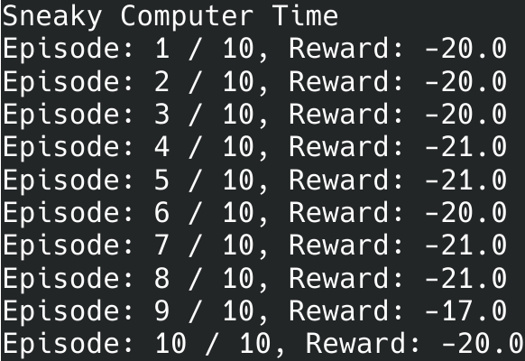
Benefits of Hidden Environment
Gives demonstrator feedback on the overall performance of the agent
Training happens here to keep interactivity in shared environment
Option to explore environment through non-optimal actions
Ex: Running 10 simulations to the side and the results

Slide 12
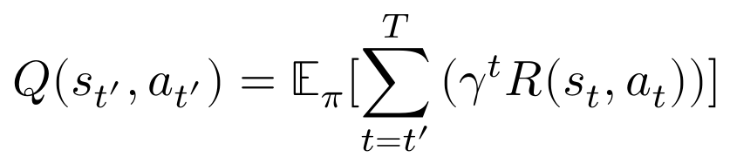
How Agents Select Actions
Choose action, a, for a given state, s, that maximizes Q(s, a)
Q-value estimates improve as the agent experiences more
The agent selects better actions as it knows which produce higher expected rewards
Discounted reward

Slide 13
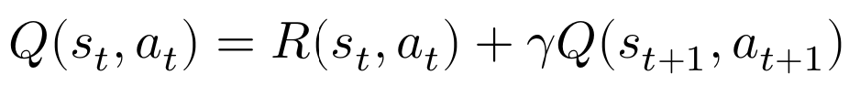
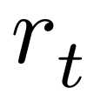
Bellman Equation
One way the agent can “check its work” is if their approximation of the Q-value function satisfies the Bellman Equation
We have the necessary components from the experiences in the memory!

Slide 14

What’s (discount factor)
Controls how short-sighted your agent is
As approaches 1, all experiences are treated equally
As approaches 0, the agent starts to prefer short-term gains

Slide 15

Training
Goal: minimal amount of error in the Q-value function
Bellman Equation Expansion of

Slide 16
3 Stages of Interactive Demonstrations
Demonstrator with shared environment
m minutes
m minutes
Agent with shared environment
Agent with hidden environment
Visual
Feedback
Numerical
Feedback
e episodes

Slide 17
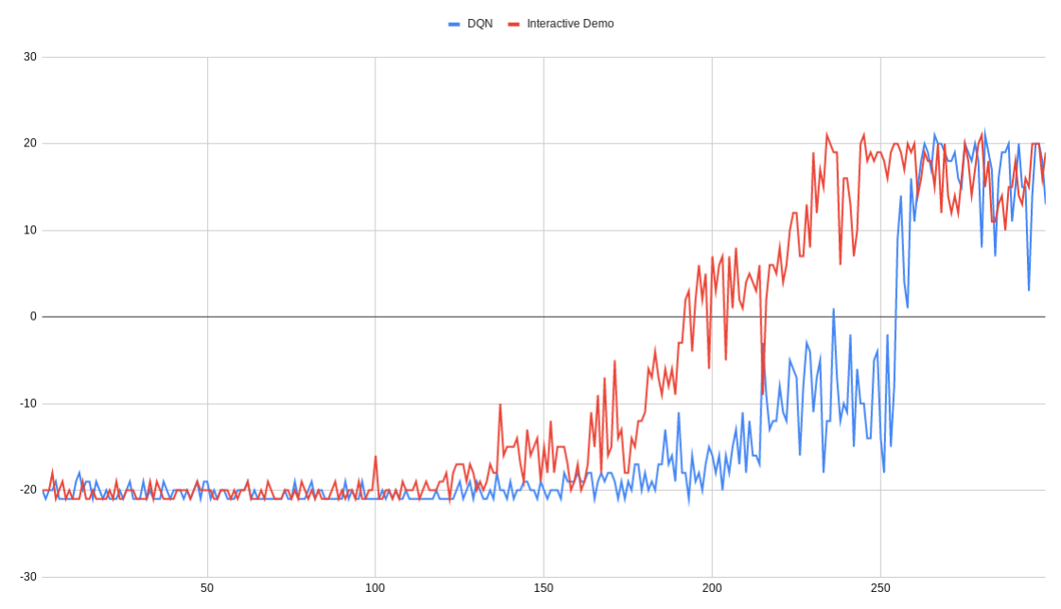
Results
Interactive Demo DQN
Interactive demonstrations
is faster at winning the game and reaching the max score of 21

Slide 18
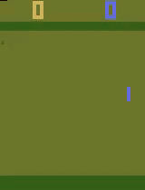
Thanks!

